Slide 1
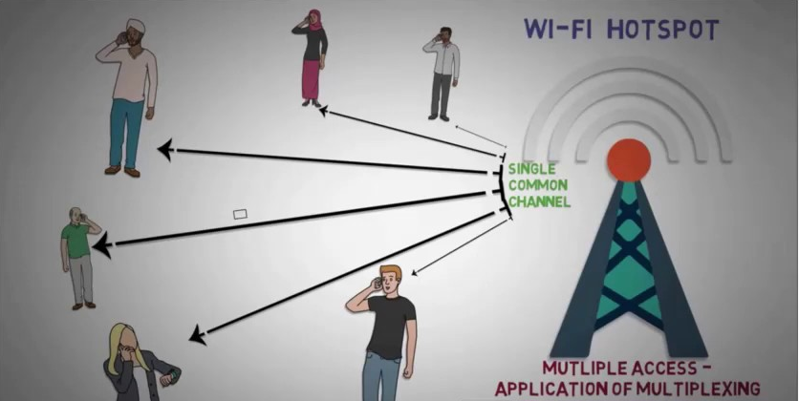
MULTIPLE ACCESS TECHNIQUES

Slide 2
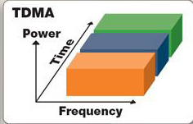
OVERVIEW
Introduction to Multiple Access
FDMA
TDMA
Spread Spectrum Multiple Access

Slide 3
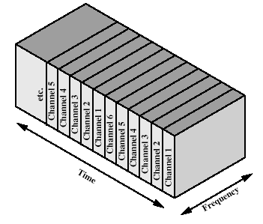
Time Division Multiple Access
Time slots
One user per slot
Buffer and Burst method
Non-continuous transmission
Digital data
Digital Modulation

Slide 4
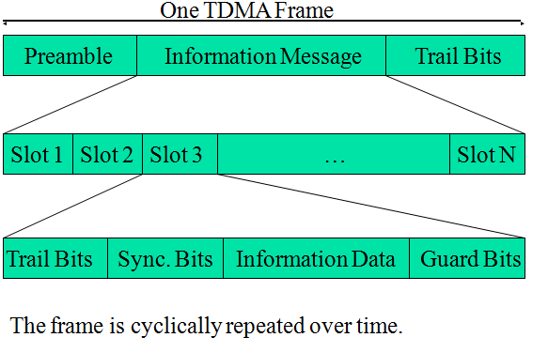
Repeating Frame Structure

Slide 5
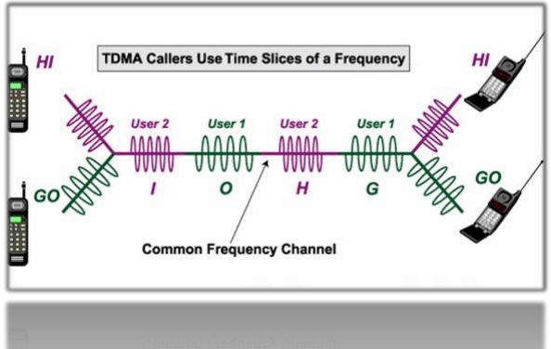
Features of TDMA
TDMA uses different time slots for Tx and Rx, thus duplexers are not required.
Global Systems for Mobile communications (GSM) uses the TDMA technique.

Slide 6
Features of TDMA
In digital systems, continuous transmission is not required because users do not use the allotted bandwidth all the time.
In such cases, TDMA is a complimentary access technique to FDMA.
TDMA shares a single carrier frequency with several users where each users makes use of non overlapping time slots.
The number of time slots per frame depends on several factors such as modulation technique, available bandwidth etc.
In TDMA, the entire bandwidth is available to the user but only for a finite period of time.
Data transmission in TDMA is not continuous but occurs in bursts. This results in low battery consumption since the subscriber transmitter can be turned OFF when not in use.

Slide 7
Features of TDMA
Because of a discontinuous transmission in TDMA the handoff process is much simpler for a subscriber unit, since it is able to listen to other base stations during idle time slots.
TDMA has an advantage that is possible to allocate different numbers of time slots per frame to different users.
Thus bandwidth can be supplied on demand to different users by concatenating or reassigning time slot based on priority
TDMA requires careful time synchronization since users share the bandwidth in the frequency domain.
The number of channels are less, inter channel interference is almost negligible.
TDMA uses different time slots for transmission and reception. This type of duplexing is referred to as Time division duplexing(TDD).

Slide 8
SYNCHRONIZATION IN TDMA
“CLOCK” is required for TDMA.
All transmitters and receivers must be aware of this ``clock'' to schedule
their transmissions and receptions and transmissions are synchronized.
In cellular telephone systems a clock signal indicates the beginning of time-
slots is transmitted by the base stations. From this signals, mobile stations
can determine when their turn comes up.

Slide 9
Number of channels in a TDMA system
m*(Btot - 2*Bguard)
N=
Bc
N - number of channels
m - number of TDMA users per radio channel
Btot - total spectrum allocation
Bguard - Guard Band
Bc - channel bandwidth

Slide 10
Example: Global System for Mobile (GSM)
TDMA/FDD
forward link at Btot = 25 MHz
radio channels of Bc = 200 kHz
if m = 8 speech channels supported, and
if no guard band is assumed
8*25E6
N=
= 1000 simultaneous users
200E3

Slide 11
Efficiency of TDMA
bOH = Nr*br + Nt*bp + Nt*bg + Nr*bg
bOH - number of overhead bits
Nr - number of reference bursts per frame
br - reference bits per reference burst
Nt - number of traffic bursts per frame
bp - overhead bits per preamble in each slot
bg - equivalent bits in each guard time interval

Slide 12
Efficiency of TDMA
bT = Tf * R
bT - total number of bits per frame
Tf - frame duration
R - channel bit rate

Slide 13
Efficiency of TDMA
f = (1-bOH/bT)*100%
f - frame efficiency
bOH - number of overhead bits per frame
bT - total number of bits per frame

Slide 14
ADVANTAGES
It carry data rates of 64 kbps to 120 Mbps .
It provides the user with extended battery life and talk time.
It is the most cost effective technology to convert an analogue system to
digital.
TDMA technology separates users according to time, it ensures that there
will be no interference.
TDMA allows the operator to do services like fax, voice band data, and
SMS as well as bandwidth-intensive application such as multimedia and
videoconferencing.

Slide 15
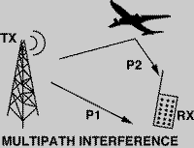
DISADVANTAGES
Each user has a predefined time slot. When moving from one cell to
other, if all the time slots in this cell are full the user might be
disconnected.
It is subjected to multipath distortion. A signal coming from a tower to
a handset might come from any one of several directions. It might
have bounced of several different buildings before arriving.

Slide 16
FDMA vs TDMA
Frequency division is very simple: all transmitters sharing the medium have output power spectra in overlapping bands.
– Many of the problems experienced in TDMA due to different propagation delays are eliminated in FDMA.
The major disadvantage of FDMA is the relatively expensive and complicated bandpass filters required.
– TDMA is realized primarily with much cheaper logic functions.
Another disadvantage of FDMA is the rather strict linearity requirement of the medium.

Slide 17
THANK YOU

